Slide 1
FATONI UNIVERSITY
FACULTY OF SCIENCE AND TECHNOLOGY
DEPARTEMENT OF INFORMATION TECHNOLOGY
LECTURER:
MR. KHORLED LANGSARI
COURSE:
MODERNING LANGUAGE

Slide 2
PRENSENTATIOM
REGISTRATIOM & LOGIN FEATURES OF RENTAL APPLICATION
PRESENTER NAME:
MR. SMAN MATLY (591431029)

Slide 3
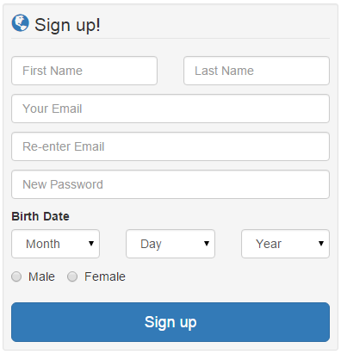
Customer Registration
First Name
Last Name
Username
ID Card(FTU)
Gender
Email
Password
Address
1

Slide 4
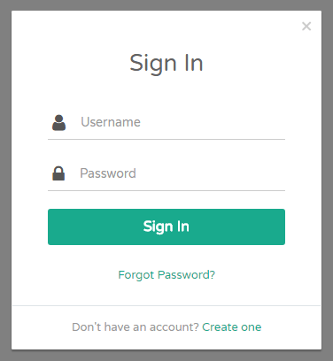
Customer Login
Email or Username
Password
2

